Slide 1
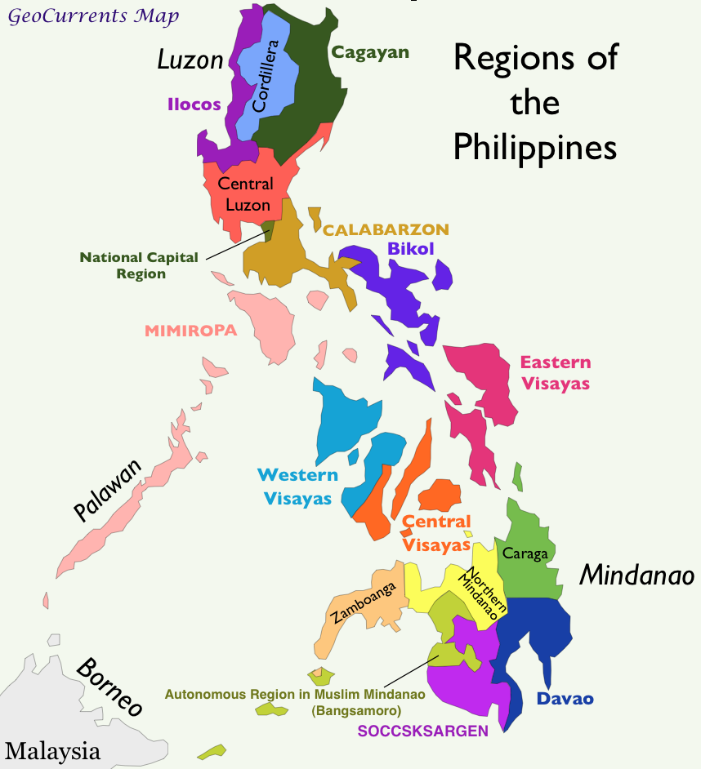
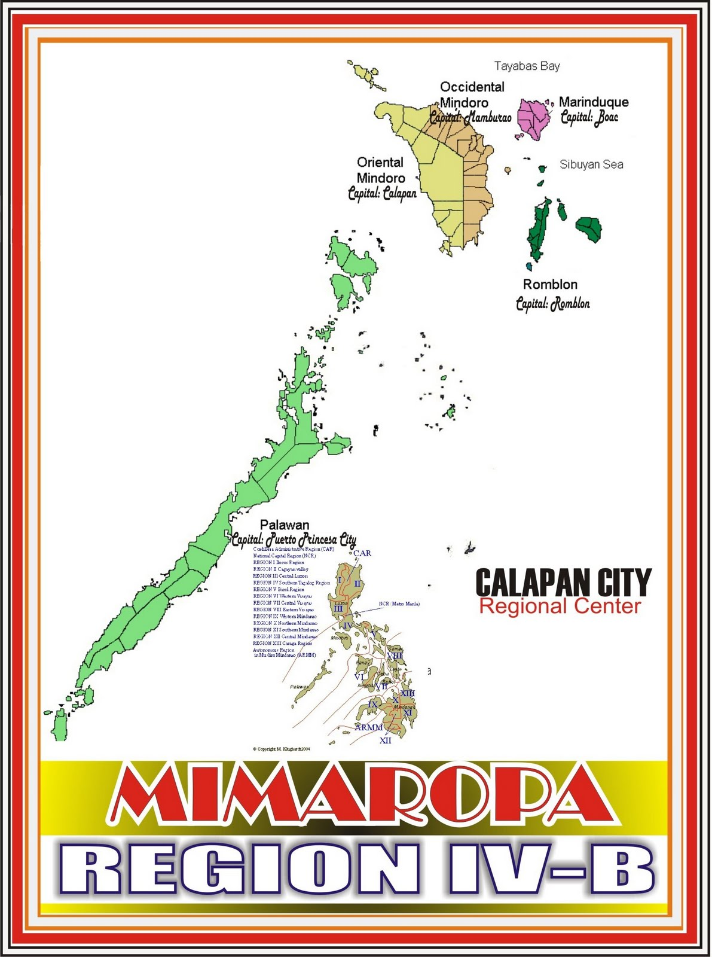
Region IV-B(MiMaRoPa)
MiMaRoPa Region

Slide 2
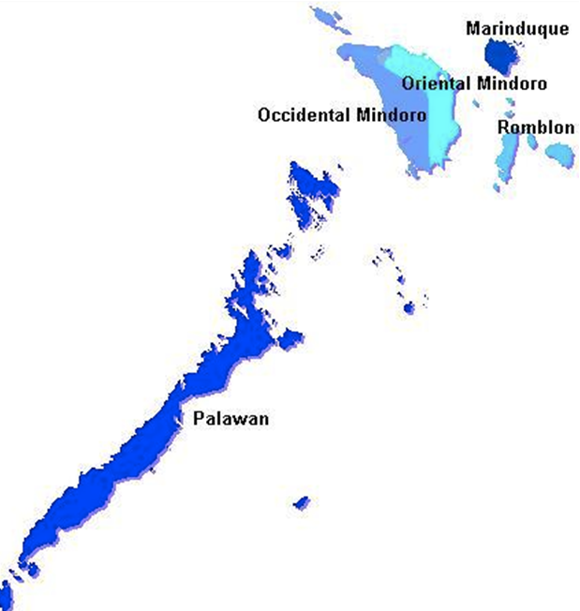
ORIENTAL MINDORO
Registered Programs = 139
TVIs = 46
Assessors = 119
Assessment Centers = 68
MARINDUQUE
Registered Programs = 41
TVIs = 6
Assessors = 43
Assessment Centers = 22
OCCIDENTAL MINDORO
Registered Programs = 35
TVIs = 10
Assessors = 22
Assessment Centers = 30
ROMBLON
Registered Programs = 25
TVIs = 7
Assessors = 41
Assessment Centers = 19
PALAWAN
Registered Programs = 100
TVIs = 24
Assessors = 140
Assessment Centers = 73

Slide 3
Land Area, Provinces, Cities, Municipalities and Barangays
 | Land Area | No. of Provinces | No. of Cities | No. of Municipalities | No. of Barangays
MIMAROPA | 2,745,601 hectares | 5 | 2 | 71 | 1,458

Slide 4
Population, City, Municipality and Barangay Per Province
PROVINCES | Population (2015) | No. of Cities | No. of Municipalities | No. of Barangays
Marinduque | 235,000 | - | 6 | 218
Occidental Mindoro | 487,000 | - | 11 | 162
Oriental Mindoro | 844,000 | 1 | 14 | 426
Palawan | 1,104,000 | 1 | 23 | 433
Romblon | 293,000 | - | 17 | 219
Total | 2,963,000 | 2 | 71 | 1,458

Slide 5
Population By Age and Sex
Age (2010) |  |  | Sex (2010)
0-14 yrs | 15-64 yrs | 65 yrs and above | Male | Female
1,012,914 | 1,601,270 | 117,744 | 1,400,061 | 1,331,867

Slide 6
Population By Province
Province | POPULATION (CENSUS 2015)
Marinduque | 235,521
Occidental Mindoro | 487,414
Oriental Mindoro | 844,059
Palawan | 1,104,585
Romblon | 293,781
TOTAL | 2,963,360

Slide 7
Basic Education
Enrolment in Public Elementary Schools (As of Sept 2015) |  |  | Enrolment in Public Secondary Schools (As of Sept 2015)
Male | Female | Total | Male | Female | Total
279,244 | 253,196 | 532,440 | 104,590 | 107,284 | 211,874

Slide 8
Employment Indicators
Labor Force and Rates of Labor Force Participation, Employment, Unemployment and Underemployment JULY 2016
Labor Force (in ‘000) | 2,005
Labor Force Participation Rate | 63.7
Employment Rate | 95.7
Unemployment Rate | 4.3
Underemployment Rate | 26.6

Slide 9
Economy
GRDP: Share by Industrial Origin, 2013
Industry | 32.8%
Service | 24%
Agriculture | 43.2%
MIMAROPA contributed 1.65 percent to the country’s Gross Domestic
Product.
In 2013, GRDP grew by 1.68 percent. Agriculture, Hunting, Forestry and Fishing sector contributed 23.97 percent to the regional economy.
It registered a 2.97 percent decrease in 2013.

Slide 10
Economy
MIMAROPA’s economy slowed down to 1.7 percent in 2013
The growth of MIMAROPA’s economy slowed down from 4.8 percent in 2012 to 1.7 percent in 2013.
Contractions in AHFF and Industry sector weighed heavily on the region’s economy.
Services remained the biggest contributor to MIMAROPA’s economy with a 43.2 percent share in 2013, slightly higher than its 40.5 percent share a year ago.
Industry followed, accounting for 32.8 percent and the AHFF contributed the least at 24.0 percent.
Agriculture, Hunting, Forestry and Fishing (AHFF) Sector continued its decline by contracting further by 3.0 percent in 2013, from its 0.3 percent decline recorded a year ago. The 0.7 percent growth in Agriculture and Forestry was not enough to compensate for the 11.9 percent slump in Fishery to keep AHFF afloat.

Slide 11
Business and Industry
Major Industries | No. of Establishments
 | 2013
Agriculture and Forestry/agriculture, hunting and forestry/agriculture, forestry and fishing | 1,721
Mining and Quarrying | 2,174
Manufacturing | 939
Electricity, Gas and Water/electricity, gas, steam and air conditioning supply | 1,426
Construction | 445
Wholesale and retail trade, repair of motor vehicles, and motorcycles | 3,782
Hotels and Restaurants/Accommodation and food service activities | 3,574
Transportation/transport, storage and communications/transport and storage | 509
Financial intermediation/financial and insurance activities | 3,002
Education/Private education | 2,554
Health/health and social work/human health and social work | 1,158
Water supply, sewerage, waste management and remediation activities | 418
Information and communication | 224
Administrative and Support Activities | 448

Slide 12
Training Providers and Registered Programs
Province | 2016 No. of Training Providers |  |  | 2016 Number of Registered Programs
 | Public | Private | Total | WTR | NTR | Total
Marinduque | 2 | 4 | 6 | 41 |  | 41
Occidental Mindoro |  | 10 | 10 | 35 |  | 35
Oriental Mindoro | 11 | 35 | 46 | 136 | 3 | 139
Palawan | 3 | 21 | 24 | 96 | 4 | 100
Romblon | 1 | 6 | 7 | 25 |  | 25
RO-Mobile |  | 20 | 20 | 35 |  | 35
Total | 19 | 93 | 118 | 368 | 7 | 375

Slide 13
Program Registration 2016
Top 10 Registered Programs
Rank | Programs | Number
1 | Food and Beverage Services NC II | 22
2 | Housekeeping NC II | 20
3 | Shielded Metal Arc Welding NC II | 19
4 | Bread and Pastry Production NC II | 17
5 | Computer Systems Servicing NC II | 16
6 | Electronics Products Assembly and Servicing NC II | 14
7 | Cookery NC II | 12
7 | Driving NC II | 12
8 | Motorcycle/Small Engine Servicing NC II | 11
8 | Shielded Metal Arc Welding NC I | 11
9 | Caregiving NC II | 10
9 | Electrical Installation and Maintenance NC II | 10
9 | Health Care Services NC II | 10
10 | Automotive Servicing NC I | 9
10 | Automotive Servicing NC II | 9
10 | Bookkeeping NC III | 9
10 | Events Management Services NC III | 9
10 | Gas Tungsten Arc Welding NC II | 9

Slide 14
NATIONAL TVET TRAINERS CERTIFICATION (NTTC) 2016
Province | No. of NTTC Certified Trainers
Marinduque | 131
Occidental Mindoro | 75
Oriental Mindoro | 294
Palawan | 218
Romblon | 59
Total | 777

Slide 15
NTTC 2016
Top 10 NTTC Per Qualification
Rank | Qualifications | No. of NTTC
1 | Housekeeping NC II | 62
2 | Bread and Pastry Production NC II | 47
2 | SMAW NC II | 47
3 | Computer Systems Servicing NC II | 44
4 | Food and Beverage Services NC II | 43
5 | Driving NC II | 38
6 | Electrical Installation and Maintenance NC II | 37
7 | Bookkeeping NC III | 25
7 | Events Management Services NC III | 25
8 | Barista NC II | 23
9 | Hilot (Wellness Massage) NC II | 22
10 | Food Processing NC II | 20
10 | Front Office Services NC II | 20

Slide 16
REGISTRY OF ACCREDITED ASSESSMENT CENTERS AND ASSESSORS 2016
PROVINCE | Accredited Assessment Centers | Accredited Assessors
Marinduque | 22 | 43
Occidental Mindoro | 30 | 22
Oriental Mindoro | 68 | 119
Palawan | 73 | 140
Romblon | 19 | 41
TOTAL | 212 | 365

Slide 17
REGISTRY OF ACCREDITED ASSESSORS BY QUALIFICATION 2016
PROVINCE | Accredited Assessors | No. of Qualifications
Marinduque | 43 | 26
Occidental Mindoro | 22 | 17
Oriental Mindoro | 119 | 40
Palawan | 140 | 46
Romblon | 41 | 19
TOTAL | 365 | 148

Slide 18
REGISTRY OF ACCREDITED ASSESSMENT CENTERS BY QUALIFICATION 2016
PROVINCE | No. of Accredited Assessment Centers | No. of Qualifications
Marinduque | 22 | 21
Occidental Mindoro | 30 | 24
Oriental Mindoro | 68 | 40
Palawan | 73 | 50
Romblon | 19 | 15
TOTAL | 212 | 150

Slide 19
Number of Assessed and Certified By Province 2016
PROVINCE | Assessed | Certified | Certification Rate
Marinduque | 5434 | 4830 | 89%
Occidental Mindoro | 4031 | 3169 | 79%
Oriental Mindoro | 11997 | 10154 | 85%
Palawan | 11509 | 10975 | 95%
Romblon | 2826 | 2815 | 99%
TOTAL | 35797 | 32003 | 89%

Slide 20
Competency assessment 2016
Top 10 Assessed Per Qualification
Rank | Qualification | Number of Assessed
1 | Computer Systems Servicing NC II | 2037
2 | Motorcycle/Small Engine Servicing NC II | 1876
3 | Housekeeping NC II | 1722
4 | Electronics Products Assembly and Servicing NC II | 1715
5 | Shielded Metal Arc Welding NC II | 1696
6 | Bread and Pastry Production NC II | 1661
7 | Driving NC II | 1622
8 | Scaffold Erection NC II | 1584
9 | Barista NC II | 1254
10 | Electrical Installation and Maintenance NC II | 1147

Slide 21
Competency Assessment and Certification for Workers (CACW) 2016
Province | Assessed | Certified
Marinduque | 600 | 600
Occidental Mindoro | 92 | 73
Oriental Mindoro | 598 | 576
Palawan | 634 | 634
Romblon | 100 | 84
Total | 2024 | 1967

Slide 22
PEGACE Targets and Accomplishments 2016
MIMAROPA | Targets | Accomplishment | %
Profiled | 22,300 | 26,857 | 120%
Enrolled | 65,018 | 51,092 | 79%
Graduates | 58,517 | 52,308 | 89%
Assessed | 33,550 | 35,797 | 107%
Certified | 28,518 | 32,003 | 112%
Employed (TTIs only) | 2,035 | 1,548 | 76%

Slide 23
Training Targets and Accomplishments 2016
Province | Institution-Based |  | Community-Based |  | Enterprise-Based |  | Total
 | Enr | Grad | Enr | Grad | Enr | Grad | Enr | Grad
Marinduque | 3956 | 3497 | 4879 | 4884 | 28 | 27 | 8863 | 8408
Occidental Mindoro | 2693 | 2283 | 5819 | 5819 | 61 | 27 | 8573 | 8129
Oriental Mindoro | 4827 | 5354 | 6051 | 6203 | 31 | 31 | 10909 | 11588
Palawan | 14845 | 16713 | 3787 | 3812 | 55 | 54 | 18687 | 20579
Romblon | 2930 | 2474 | 1130 | 1130 |  |  | 4060 | 3604
Total | 29251 | 30321 | 21666 | 21848 | 175 | 139 | 51092 | 52308

Slide 24
Training Output Percent to Total Output Per Province 2016
Province | Institution-Based |  | Community-Based |  | Enterprise-Based |  | Total
 | Enr | Grad | Enr | Grad | Enr | Grad | Enr | Grad
Marinduque | 13% | 11% | 23% | 22% | 16% | 19% | 17% | 16%
Occidental Mindoro | 9% | 8% | 27% | 27% | 35% | 19% | 17% | 16%
Oriental Mindoro | 17% | 18% | 28% | 28% | 18% | 22% | 21% | 22%
Palawan | 51% | 55% | 17% | 17% | 31% | 39% | 37% | 39%
Romblon | 10% | 8% | 5% | 5% | 0% | 0% | 8% | 7%
Total | 100% | 100% | 100% | 100% | 100% | 100% | 100% | 100%

Slide 25
No. of Profiled and Enrolled 2016
Province | Profiled | Enrolled | Profiled % to Enrolled
Marinduque | 3725 | 8863 | 42%
Occidental Mindoro | 2583 | 8573 | 30%
Oriental Mindoro | 5120 | 10909 | 47%
Palawan | 13495 | 18687 | 72%
Romblon | 1934 | 4060 | 48%
Total | 26857 | 51092 | 53%

Slide 26
Institution-Based Enrolled
Top 10 Enrolled Per Qualification Per Province
Province | Rank | Qualifications | Enrolled
Marinduque | 1 | SMAW NC II | 444
 | 2 | Barista NC II | 375
 | 3 | SMAW NC I | 310
 | 4 | Computer Systems Servicing NC II | 280
 | 5 | Masonry NC II | 265
 | 6 | Carpentry NC II | 264
 | 7 | Events Management Services NC II | 250
 | 8 | Front Office Services NC II | 235
 | 9 | Bread and Pastry Production NCII | 209
 | 10 | Gas Tungsten Arc Welding NC II | 130

Slide 27
Institution-Based Enrolled
Top 10 Enrolled Per Qualification Per Province
Province | Rank | Qualifications | Enrolled
Occidental | 1 | Electronics Products Assembly and Servicing NC II | 520
Mindoro | 2 | Motorcycle/Small Engine Servicing NC II | 338
 | 3 | SMAW NC II | 175
 | 4 | SMAW NC I | 144
 | 5 | Cookery NC II | 114
 | 6 | Computer Systems Servicing NC II | 110
 | 7 | Bread and Pastry Production NC II | 107
 | 8 | Barista NC II | 100
 | 8 | Scaffold Erection NC II | 100
 | 9 | Hilot (Wellness Massage) NC II | 96
 | 10 | Tourism Promotion Services NC II | 75

Slide 28
Institution-Based Enrolled
Top 10 Enrolled Per Qualification Per Province
Province | Rank | Qualifications | Enrolled
Oriental | 1 | Electronics Products Assembly and Servicing NC II | 553
Mindoro | 2 | SMAW NC II | 488
 | 3 | Motorcycle/Small Engine Servicing NC II | 453
 | 4 | Housekeeping NC II | 433
 | 5 | Barista NC II | 411
 | 6 | Bread and Pastry Production NC II | 386
 | 7 | Scaffold Erection NC II | 354
 | 8 | Computer Systems Servicing NC II | 321
 | 9 | Food and Beverage Services NC II | 219
 | 9 | Plumbing NC II | 219
 | 10 | Carpentry NC II | 175

Slide 29
Institution-based enrolled
Top 10 Enrolled Per Qualification Per Province
Province | Rank | Qualifications | Enrolled
Palawan | 1 | Heavy Equipment Operation (Rigid On-Highway Dump Truck) NC II | 2667
 | 2 | HEO (Backhoe Loader) NC II | 2207
 | 3 | HEO (Wheel Loader) NC II | 1837
 | 4 | HEO (Bulldozer) NC II | 1648
 | 5 | Driving NC II | 1139
 | 6 | Food and Beverage Services NC II | 757
 | 7 | Computer System Servicing NC II | 613
 | 8 | Bread and Pastry Production NC II | 472
 | 9 | Bookkeeping NC III | 454
 | 10 | Housekeeping NC II | 423

Slide 30
Institution-based enrolled
Top 10 Enrolled Per Qualification Per Province
Province | Rank | Qualifications | Enrolled
Romblon | 1 | Food and Beverage Services NC II | 367
 | 2 | Hilot (Wellness Massage) NC II | 292
 | 3 | Cake Making (Leading to BPP NC II) | 168
 | 4 | Front Office Services NC II | 160
 | 4 | Housekeeping NC II | 160
 | 5 | Bread and Pastry Production NC II | 158
 | 6 | Automotive Servicing NC II | 157
 | 7 | Automotive Servicing NC I | 151
 | 8 | Electrical Installation and Maintenance NC II | 146
 | 9 | Bread Making (Leading to BPP NC II) | 139
 | 10 | Bartending NC II | 135

Slide 31
TESDA Technology Institutions
TTI | Enrolled | Graduates | Assessed | Certified | Employed
BSAT | 856 | 586 | 329 | 329 | 220
TPSAT | 465 | 373 | 346 | 326 | 203
SSVTC | 1,021 | 966 | 926 | 857 | 381
PPSAT | 1,987 | 1,660 | 1,604 | 1,417 | 605
ANTS | 645 | 390 | 682 | 628 | 528

Slide 32
TVET SITUATIONER 2011-2016
CY | Profiled | Enrolled | Graduates | Assessed | Certified | Employed
2011 | 14594 | 63453 | 55022 | 35,309 | 29,798 | 22514
2012 | 27702 | 64632 | 54835 | 47,840 | 41,396 | 23445
2013 | 29767 | 57423 | 50261 | 47,144 | 45,557 | 21189
2014 | 43491 | 45368 | 40721 | 21,247 | 19,129 | 21453
2015 | 27287 | 60922 | 55144 | 33,550 | 29,294 | 8672
2016 | 26857 | 51092 | 52308 | 35797 | 32003 | 1992
TOTAL | 169698 | 342890 | 308291 | 220887 | 197177 | 99265

Slide 33
Enterprise-Based Partners
Institution | Areas of Partner-ship | Qualification | Name of Partner | Address
TPSAT | DTP | RAC Servicing NC II | JAHV Airconditioning Services | Marikina City
 |  |  | DM Hernandez Engineering | Pasig City
 |  |  | Globalaire Technology Corporation | Makati City
PPSAT | DTP | Housekeeping NC II | Voyagers Palace | Puerto Princesa City
 |  | Housekeeping NC II | Persal Hotel | Puerto Princesa City
 |  | Housekeeping NC II | Amerson Pension Place | Puerto Princesa City
 | DTS | Housekeeping NC II | Aziza Paradise Hotel | Puerto Princesa City
CINI | DTP | Cookery NC II | Biboy’s Bar and Restaurant | San Jose, Occidental Mindoro

Slide 34
Partners
Province | Areas of Partnership | Name of Partner | Address
Marinduque | Skills Training - DTP | JAHV Airconditioning Services | Marikina City
 |  | DM Hernandez Engineering | Pasig City
 |  | Globalaire Technology Corp. | Makati City

Slide 35
Partners
Province | Areas of Partnership | Name of Partner | Address
Occidental Mindoro | Scholarship- BUB | LGU-San Jose | San Jose, Occidental Mindoro
 |  | LGU-Rizal | Rizal, Occidental Mindoro
 |  | LGU-Sablayan | Sablayan, Occ. Mindoro
 |  | LGU-Paluan | Lubang, Occ. Mindoro
 | Skills Training - DTP | Biboy’s Bar and Restaurant | San Jose, Occ. Mindoro

Slide 36
Partners
Province | Areas of Partnership | Name of Partner | Address
Oriental Mindoro | Scholarship- BUB | LGU-Bulalacao | Bulalacao, Oriental Mindoro
 |  | LGU-Pinamalayan | Pinamalayan, Or. Mindoro
 |  | LGU-Puerto Galera | Puerto Galera, Or. Mindoro
 |  | LGU-Naujan | Naujan, Or. Mindoro
 |  | LGU-Gloria | Gloria, Or. Mindoro
 | CACW-PNP Personnel | PNP-Oriental Mindoro | Calapan City, Or. Mindoro
 | CACW-TLE Teachers | DepEd-OMNHS | Calapan City, Or. Mindoro
 | Scholarship-TWSP | PGOM-LSI | Calapan City, Or. Mindoro
 | Livelihood Skills Training | ALS-Naujan | Naujan, Or. Mindoro

Slide 37
Partners
Province | Areas of Partnership | Name of Partner | Address
Romblon | Scholarship-BUB | Romblon State College | Odiongan, Romblon
 |  | LGU-Odiongan | Odiongan, Romblon
 |  | LGU-Looc | Looc, Romblon
 | Skills Training-CBT | Odiongan South District | Odiongan, Romblon
 | Scholarship-STEP | LGU-Ferrol | Ferrol, Romblon
 |  | LGU-San Andres | San Andres, Romblon
 | OJT | La Carmela de Boracay Hotel Resort | Malay, Aklan
 |  | Kalibo Ref and Aircon Maintenance Specialist | Malay, Aklan
 |  | RICMAR Airconditioning and General Services | Malay, Aklan
 |  | Isuzu Automotive Dealership Inc. – Pasig Branch | Pasig City
 |  | Tierodman Auto Center | Makati City

